Slide 1
Applying for a 2021 NCR-SARE Partnership Grant Pro
The Partnership Grant program is intended to foster cooperation between agriculture professionals and small groups of farmers and ranchers to catalyze on-farm research, demonstration, and education activities related to sustainable agriculture.
Advancing sustainable agriculture since 1988
www.northcentralsare.org
Notes:
Welcome to this presentation about applying for a Partnership grant in the North Central SARE program. I’m Beth Nelson, and I am one of the coordinators for this program. This presentation runs about 25 minutes, and goes over material that is in the Call for Proposals, so it would be useful to have that in front of you as you’re going through this presentation. I’m going to begin with a quick overview of SARE and North Central SARE, and I’ll emphasize some of the SARE philosophy that I hope will aid you in developing your proposals. Then I’ll go over the sections of the Partnership grant proposal, and wind up with about 15 minutes going through the online submission pages which is new this year, so I'll take a little more time to go through multiple screen shots.. We are the Sustainable Agriculture Research and Education program, commonly referred to by our acronym, SARE. We are a part of the United States Department of Agriculture, funded through the National Institute of Food and Agriculture or NIFA program. This program is intended to foster cooperation between agriculture professionals and small groups of farmers and ranchers to catalyze on-farm research, demonstration, and education activities related to sustainable agriculture. We anticipate that projects will be very similar to projects proposed through our Farmer-Rancher grants, but these projects will include an ag professional who is coordinating the collaboration, research and reporting.

Slide 2
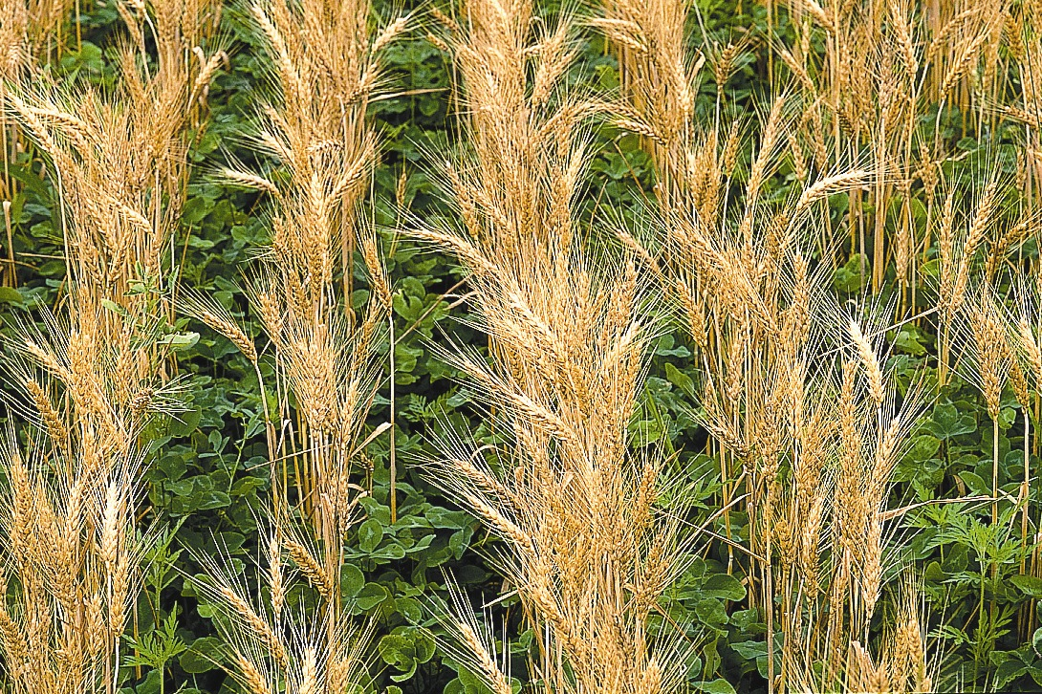
What is SARE?
Grants and outreach to advance sustainable innovations to the whole of American agriculture.
Notes:
We provide grants and outreach to advance sustainable innovations to the whole of American agriculture.

Slide 3
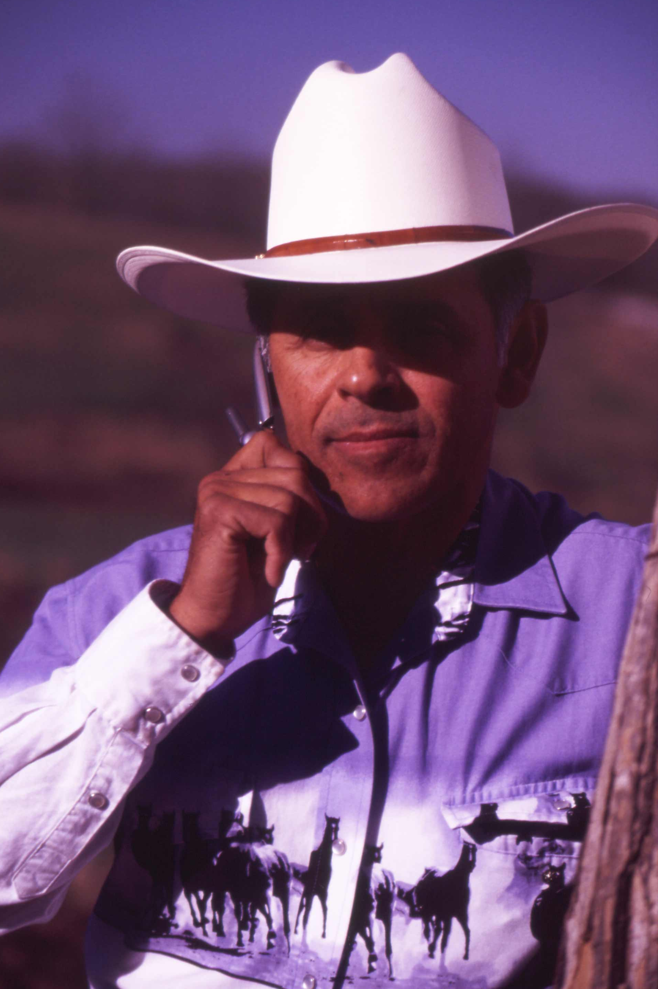
Something New and Different
SARE was started in 1988, conceived as a
decentralized, science-based, grassroots, practical, problem solving – and inclusive – competitive grant making and outreach program.
Photo by Jerry DeWitt
Notes:
This slide highlights some of the main characteristics of the SARE program--
We are decentralized, in that each of the four regions make their own funding decisions, including which grant programs to offer.
We are science-based, meaning that we expect research proposed to be planned with sufficient scientific rigor—so that findings are replicable, and we invite you to look at our bulletin on “How to Conduct Scientific Research” for more information. But we are also a grassroots grants program. Our proposal review teams and our administrative council include people with knowledge and expertise that comes from farming and working with farmers. Our proposal review teams include farmers and ranchers, extension educators, researchers and personnel from state and federal agencies. That’s an important point to remember when you’re writing your preproposal—don’t assume that everyone reviewing your proposal is an expert in your field—avoid using jargon.
In all of our grant programs, we look for projects with strong farmer/rancher or end-user involvement, and most projects are applied research projects.

Slide 4
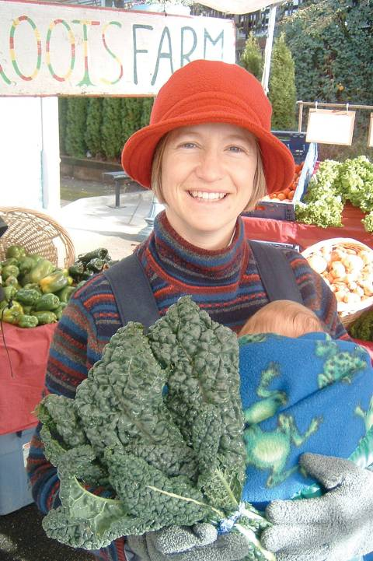
The
SARE Model
Successful SARE grantees are engaged in projects that simultaneously guided by the 3 principals of sustainability…
Profit over the long term
Stewardship of our nation’s land and water
Quality of Life for farmers, ranchers and their communities
Photo by Ted Coonfield
Notes:
Successful SARE grantees have projects that simultaneously address the 3 principals of sustainability—Quality of Life for farmers, ranchers and their communities, profit over the long term and Stewardship of our resources.
In your proposal, you should address how your project addresses each of these considerations, even if your project is focused more specifically on one of the aspects.

Slide 5
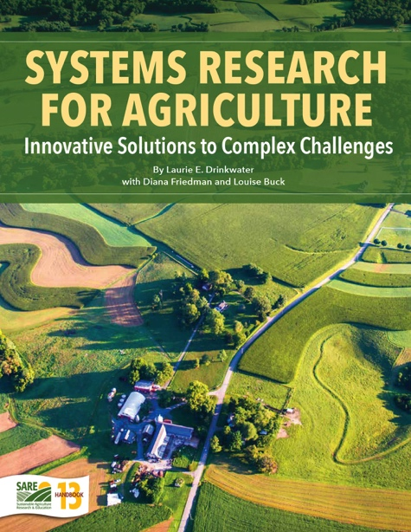
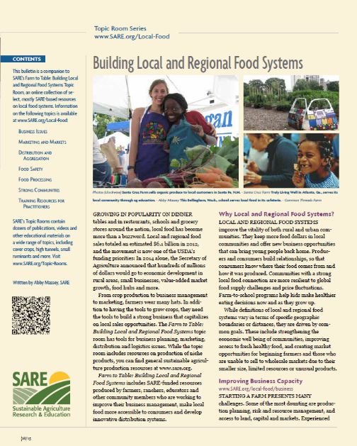
_{SARE Outreach}
a library of practical,
how-to books (in print or download for free)
media outreach
a portfolio of in-depth reports on current topics
Topic rooms for multimedia information
countless online resources, including project reports
Notes:
We are a grants and education program, and SARE Outreach produces practical information like you see here, and you can find a wealth of information online, including informative bulletins on topics from Clean Energy and Water Conservation to Marketing and Pastured Poultry. These are available to view online or download as pdfs.

Slide 6
The
SARE Portfolio
Sustainable pest and weed mgmt.
Marketing and local food systems
Water quality and nutrient mgmt.
Systems research
High tunnels and season extension
Crop diversification
Cover crops and soil health
Small ruminants/poultry/cattle
Pastured livestock/grazing systems
Pollinators and biodiversity
Urban agriculture
…and much more
Photo by Troy Bishopp
Notes:
We have funded projects on a wide range of topics.

Slide 7
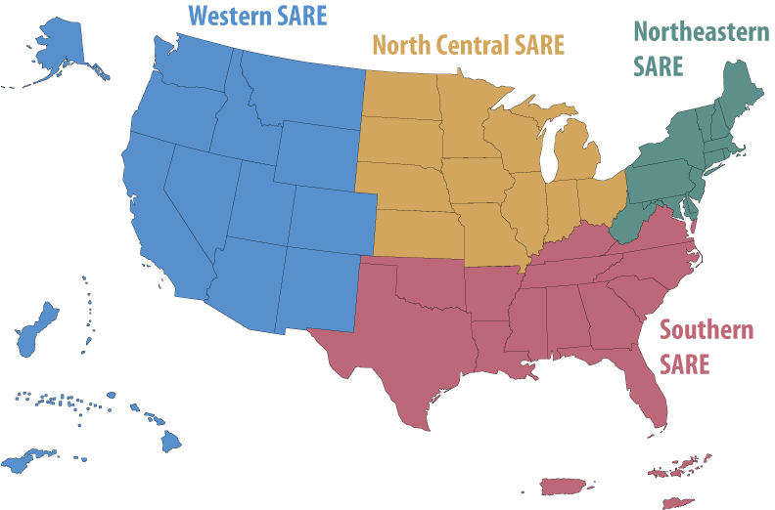
SARE
Grant Types
• Since 1988, SARE has invested
in over 7100 projects nationwide
• SARE in the North Central Region offers grants for:
Research & Education
Professional Development
Partnership
Graduate Student
Farmer/Rancher
Youth Educator
Visit www.sare.org or
www.northcentralsare.org
Photo by Carol Flaherty
Notes:
The SARE program has invested in over 7100 projects nationwide since we were funded over 30 years ago, and in the 12-state north central region, we offer these six competitive grant programs—Research and Education, Professional Development, which are train the trainer type projects, this Partnership grant program, our newest grant program, a graduate student grant program designed to help develop new researchers in sustainable agriculture, Farmer-rancher program, which are projects led by Farmers or Ranchers, and a Youth Educator program. Information on all of our grant programs can be found on our website www.northcentralsare.org and you should look at all our grant programs to determine the one that might be the best fit for your project.

Slide 8
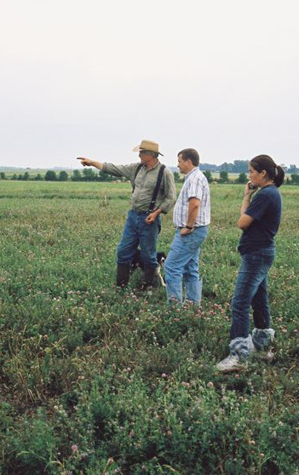
NCR-SARE Partnership Grants
Grants for up to
$40,000 total for up to 2 yrs
Can be research, demonstration, education, or marketing
Involve a team of 3 or more farmers or ranchers
Led by an ag professional
Due ONLINE Thurs., Oct. 22nd by 4:00 CDT
Photo courtesy Wayne Martin
Notes:
These are the program basics for the NCR SARE Partnership grant program. Partnership grants are for up to $40,000, for up to 2 years. Grants can be for research, OR education, or demonstration projects, but all have must have an outreach component. They should involve 3 or more farmers or ranchers, although as noted in the Call for Proposals, we recognize that there may be situations with specialty crops or livestock, or another developing area where you don’t yet have three farmers established, so feel free to contact us to discuss that type of situation. These projects will be led by an ag professional, and we anticipate funding 14 projects this year. Your proposal must be submitted online by 4:00 p.m. CDT, on Thursday, the 22nd of October.

Slide 9
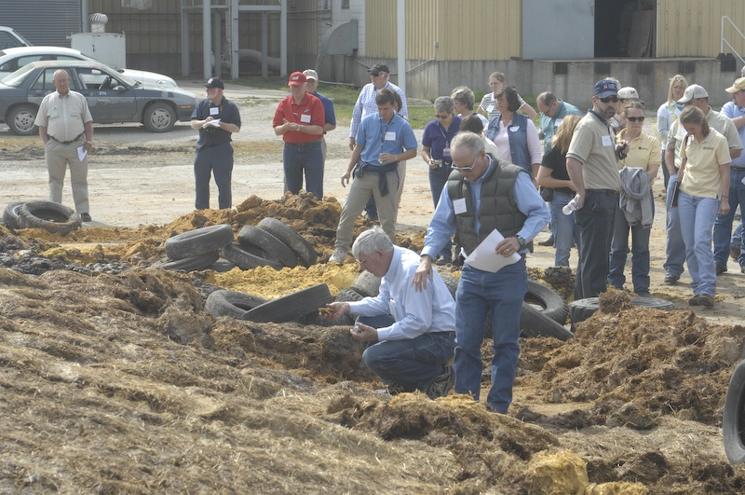
Examples of Ag Professionals
Each project is to be led by an ag professional, such as:
Extension educators (specialist/agents)
Other university educators or researchers
Non-profit organization staff
Agency staff
Certified crop advisors
Other ag and natural resource consultants
photo credit: Francis John Hay
Notes:
We define an ag professional fairly broadly--could be an extension educator, or an educator from a university or college, or a nonprofit or federal agency or state agency, or a crop advisor directly working with farmers.

Slide 10
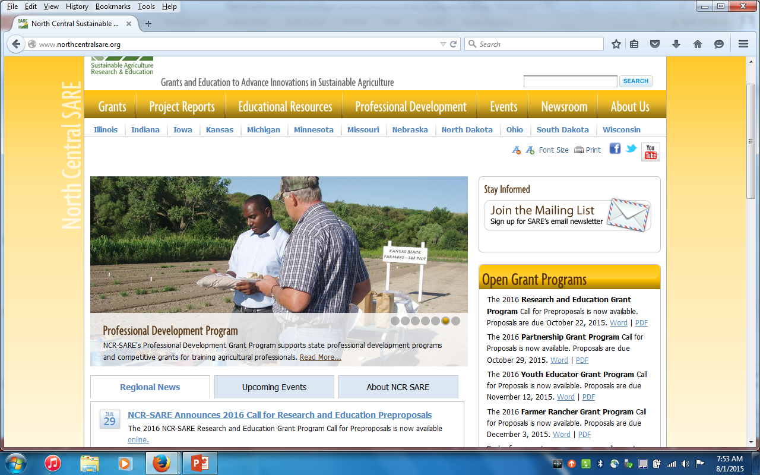
Click here to download Call for Proposals (note screen shot is from an earlier year)
Notes:
If you haven’t yet, here is how to download the 2021 Call for Proposals. If you have any problems downloading the Call for proposals, please contact the NCR-SARE office and we can email you a copy, or send a print copy. Please note that we are in the process of changing website platforms in late summer/early fall, so what you see might look different from the current screen shot. The Call lists all the sections you’ll be required to address in the online grant proposal, and the word limits.

Slide 11
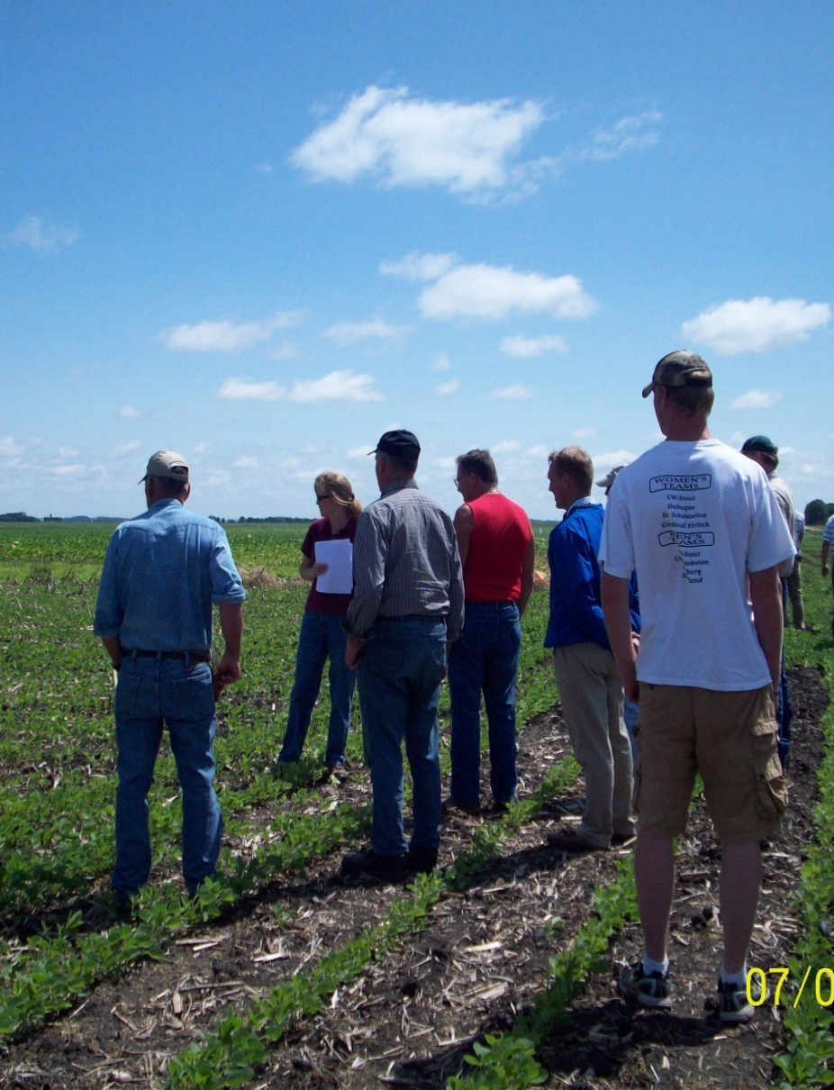
Guidelines
Proposals due October 22 by 4:00 pm CDT
Involve 3 or more farmers, with each farmer representing an independent and separate or distinct operation
Online application
Funding can cover partial salary and benefits of ag professional, on-farm research expenses, education programming, travel, etc.
Equipment expenses limited to $5000 or
less
Notes:
Here are some of the main points to keep in mind:
For equipment, you can cover leasing or rental of equipment with these funds.

Slide 12
Proposal Sections
Summary
Project objectives
Relevance to sustainable ag and regional concerns
Proposed activities, including outreach plan
Role of ag professionals, farmers or ranchers
Previous research on the topic
Outcomes and impact
Budget and budget justification
Attach resumes, signature page, letters from participating farmers
You will need to include an animal welfare statement (if applicable) but can wait until funded
Photo courtesy NRCS
Notes:
These are the specific sections of the proposal that you’ll be expected to complete in the online grant proposal application. Because there are tight word limits for each of these sections, we strongly suggest you prepare your proposal in a word processing program, so that you make sure your writing is within the word limits, and then cut and paste into the online system sections.

Slide 13
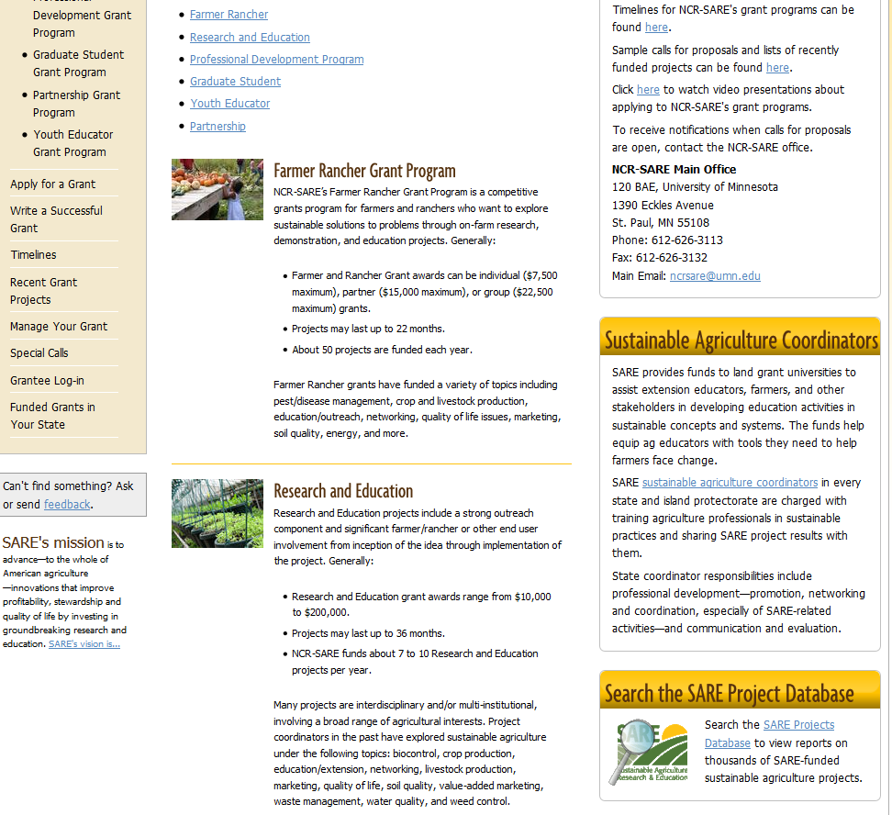
Contact your SARE state coordinator
Look up past SARE projects to see how your work differs or builds on past projects
Notes:
You can get additional help for writing grants on the NCR-SARE website. If you navigate to the Grants page, and click on our grants, you ‘ll find information about the grant programs. An important resource for you is your state NCR SARE coordinator. If you click on the link indicated in this slide, you will pull up the contact information for your state coordinator. They can discuss your idea with you, offer suggestions, and may be able to link you to collaborators. They can be especially helpful in connecting you to farmers who might be interested in your work and willing to collaborate.
You should also look at past grant projects to see how your work builds on those, and use that information in your preproposal

Slide 14
www.sare.org
Click here to search for past SARE projects
Notes:
Here is how to search the database

Slide 15
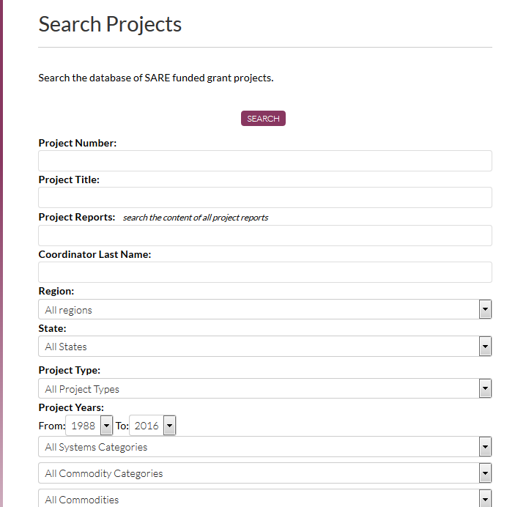
Notes:
Type in key words under “Project Reports” and you can choose the region, state, or the grant type

Slide 16
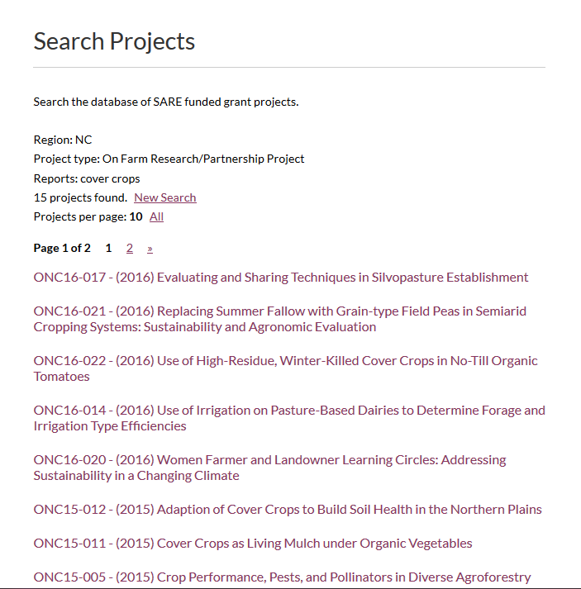
Notes:
Here is a partial list of the NCR Partnership projects that have dealt with cover crops. You can click on the title and be taken to the Project overview, or click on the annual or final reports.

Slide 17
Q&A from online NCR-SARE Partnership webinar – 9/16/2014
Q: Do the farmers listed have to be known or can it be a targeted group of farmers in a region with specific number goals? A: In most cases, at least three participating farmers should be identified and provide letters verifying participation with the application. You can add additional farmers later.
Q: Can an agency apply for both the SARE partnership grant AND another one of the SARE grants, such as R&E (for different projects). A: Yes.
Q: Is there a preference for multi-state or multi-PI proposals? A:We recognize that most of these projects will be limited to a small geographic area due to the limited amount of funds per project. So most projects will likely just involve individuals in a single state. However, if a project crosses state lines, that type of collaboration would be great, it just won’t help or hurt in the review process.
Notes:
We presented a webinar about the Partnership Grant program that went through the preceding slides and information, then addressed questions from participants. We transcribed the questions and answers on the next five slides. Following those slides we’ll present information about applying through the new online system.

Slide 18
Q&A (cont.)
Q: Can we be awarded for both the Partnership grant and the R&E? A: Yes, obviously not for the same exact work, but for different aspects of a project. If you submit different aspects of a project into both programs, you should try to propose the work so that it can be done regardless of whether the related project is funded in the other grant program. Reviewers tend to be negative about funding a project that depends on receiving additional funding from another source.
Q: Will you fund process ... leadership development projects? A: The Partnership grant program is intended to be more about on-farm research, demonstration, or education. There could potentially be a leadership component to a project, but a project focused solely on leadership development would probably not fare well. That might be a better fit with another grant program.
Q: Is matching funding of any kind required? A: No, no matching funds required.
Q: Would prior SARE funding for work that is related raise or lower an applicant in the priority considerations? A: It would not lower its competitiveness unless reviewers felt the work had already been accomplished. Reviewers like to see work that builds on previous work.

Slide 19
Q&A (cont.)
Q: If the project can secure match, financial or labor, will that increase chances of award? A: We do not request matching fund information or give points for matching funds in the review process. It might influence an individual reviewer slightly if matching funds are available, but we don’t focus on that at all in the review process. Do not include matching funds in your submitted budget, since it would then be a part of the contract and included in the accounting.
Q: Would this be an appropriate project be for farmers to get better at on-farm data collection? A: Yes.
Q: What are the key distinctions between the Partnership Grant, and the Farmer/Rancher Grant? Is it mainly the Ag Professional requirement? A. Yes.
Q: What led to these grants? A: Provided a better opportunity for ag educators who work closely with multiple farmers to apply for smaller grants to try out an idea. Non-farmers or non-ranchers are not eligible to be the lead in the Farmer-Rancher grant program. It also allows a third party to handle the grant funds without the tax burden that a farmer-rancher grant recipient has. We have also found that more and more field/county extension educators and other types of educators are needing to get grants to support projects, and these types of smaller grants are well suited for those individuals who might not have the time or ability to compete for and manage a larger USDA grant project.

Slide 20
Q&A (cont.)
Q: Is overhead allowed or not allowed? A: Up to 10 percent of total federal funds as Indirect Costs are allowed.
Q: Can one org/professional submit more than one proposal? A: Yes.
Q: Is it expected that the entire project should be completed within the time frame, or is it OK to be more of a feasibility study or pilot for a larger project later? A: The deliverables for the proposed project should be accomplished within the time frame—you might state in the narrative that pending the results, you expect longer term outcomes in projects that will follow.
Q: Can any of the funding be used for animals? A: Yes, 50% of livestock can be covered. However, it must be clear how the purchase of livestock (or equipment) is really contributing to achieving the goals and deliverables on the project. This funding is not intended to simply help a small group of beginning farmers or others get into livestock production, for example.

Slide 21
Q&A (cont.)
Q: Can funding cover honey bees? A: Can pay 100 percent for honey bees—not considered livestock in this instance.
Q: Is a bee keeper considered to be a farmer? A: Yes.
Q: If a nonprofit is a farm and education center, could it apply for both grants? The farm is a CSA - profitable but also does training of interns and area farmers. A: Yes, but you need to have involvement of three farmers/ranchers that have separate enterprises for Partnership grant. If the work is only being done on one farm, make it very clear how the other farmers are substantially involved in the project, such as helping with planning and delivering education programs or planting the research trials, etc. For Farmer-Rancher, as long as the person submitting the proposal is a farmer/rancher, they can apply.
Q: Would monitoring equipment be allowed? A: Yes, as long as it falls within the budget limits.

Slide 22
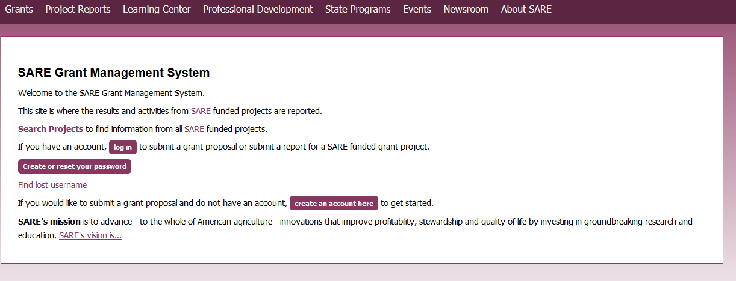
https://projects.sare.org/
Notes:
So those are the basics for preparing your proposal, and now I’m going to switch gears and walk you through the new online application system.
If you’ve never had a SARE grant before, you’ll first need to create an account and complete your user profile. Go to projects.sare.org and click on “create an account”
If you’ve had a SARE grant previously and filed reports in this system, your profile will already be in the system and you can log in with the information you used for reporting.

Slide 23
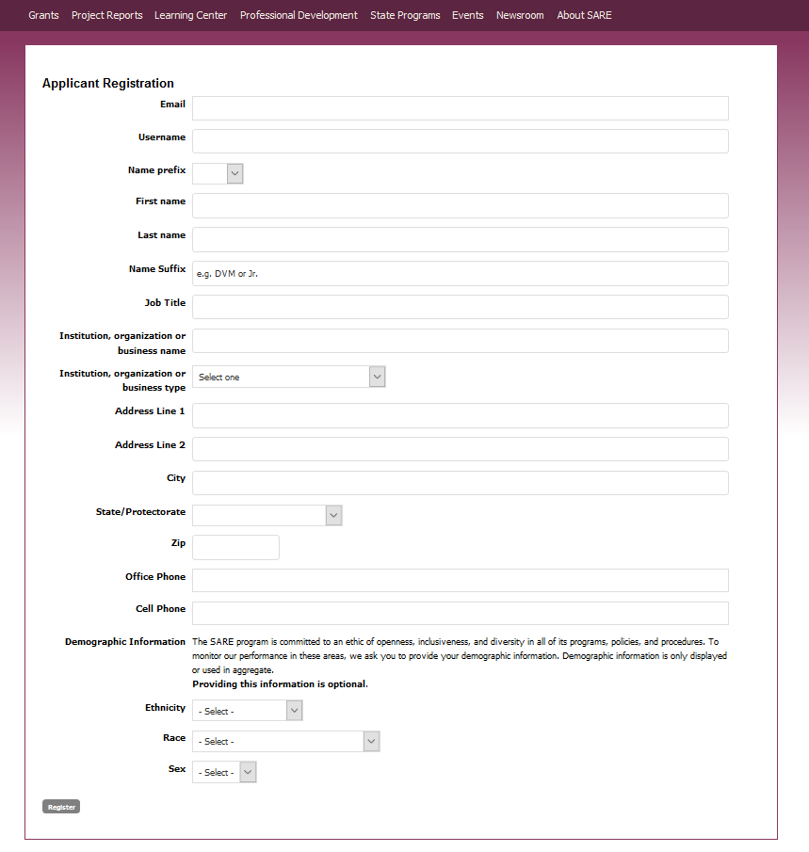
Notes:
Complete the requested information. Click on Register in the lower left hand side of the webpage

Slide 24
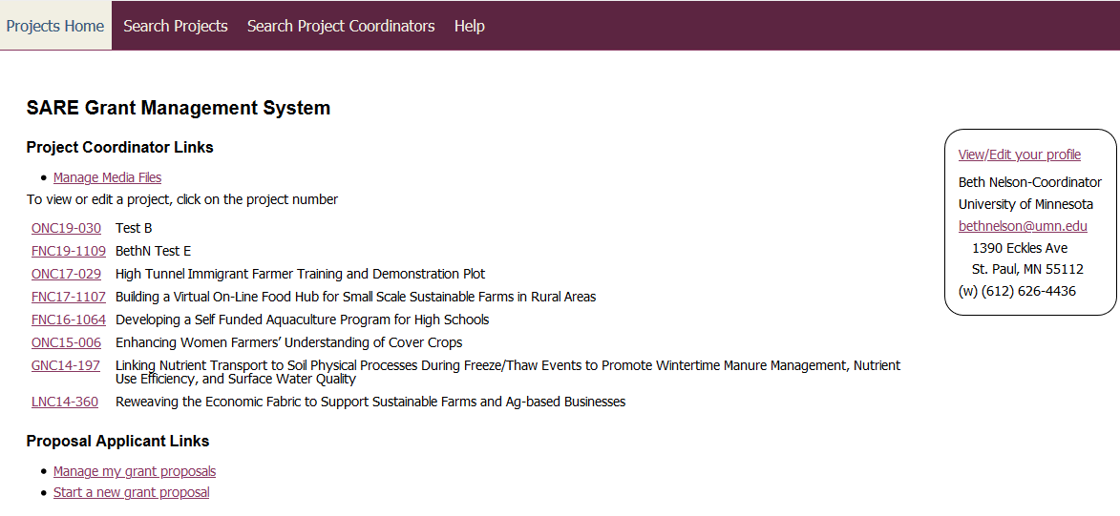
Notes:
Once you log in, you’ll see this screen. Under projects, you’ll see a list of all projects you’ve been associated with. Under Proposal Applicant Links, you’ll see a link to manage applications. This is for you to edit proposals you’ve started but not submitted.
Click on “Start a new grant proposal.”

Slide 25
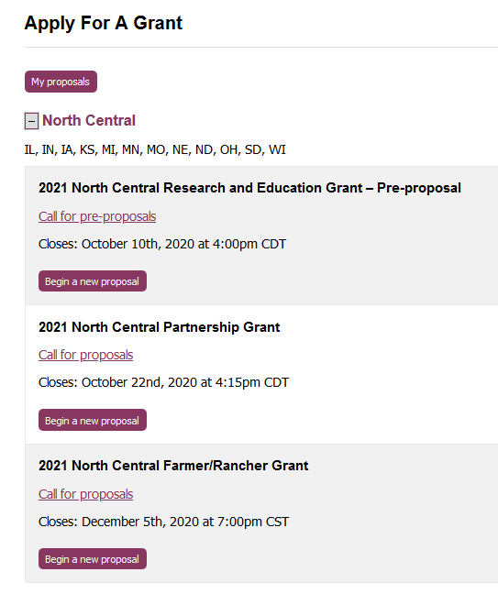
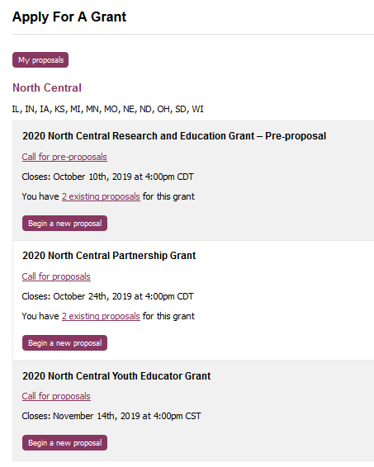
Make sure you choose the correct grant program and the North Central Region
Notes:
You will see a list of all open grant applications, for all regions.
Make sure you choose the correct grant program and the North Central Region. You will be completing the 2020 North Central Partnership application

Slide 26
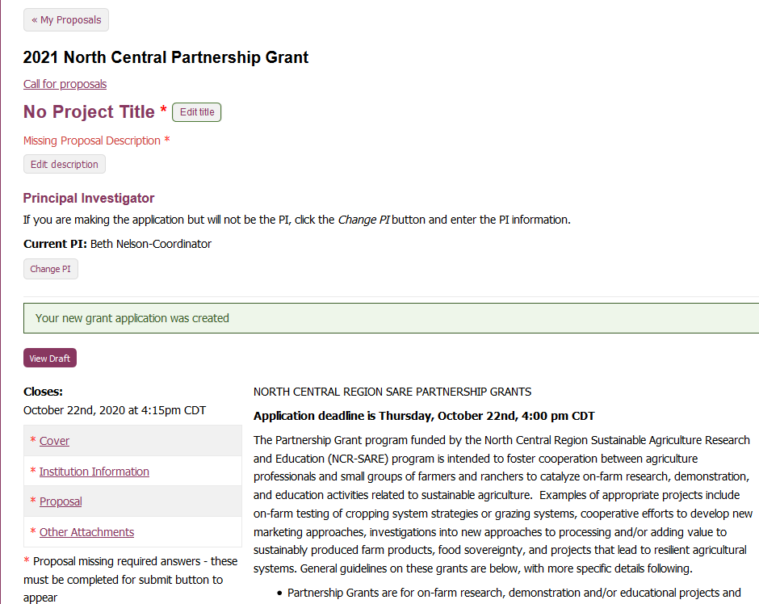
Notes:
Enter the title and brief project description (less than 160 characters). Then click on "cover"

Slide 27
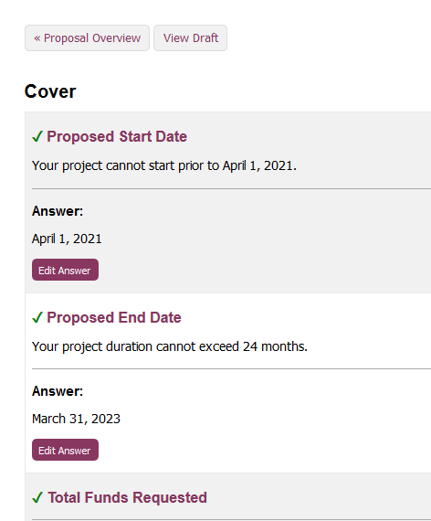
To return to main page
Click on edit answer, complete and click on SAVE. Completed questions are marked with a green check.
Notes:
Answer each question by clicking on “edit answer” and saving your answer. Questions marked with a red asterisk must be completed. Once you’ve completed the cover page information, or at any time, you can click on “Proposal Overview” to go back to the main page.

Slide 28
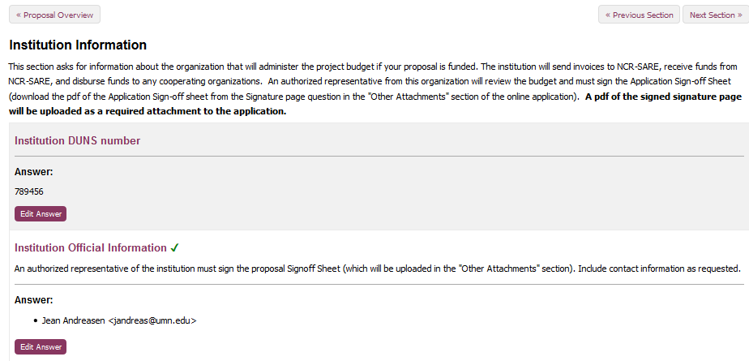
Notes:
Click on Institution information and complete the requested information. Your authorized institution representative will be the person responsible for administering grants for your organization. You will be downloading a form that you complete this information as well, and getting a signature from the person named.
Click on “Proposal Overview” to return to main page.

Slide 29
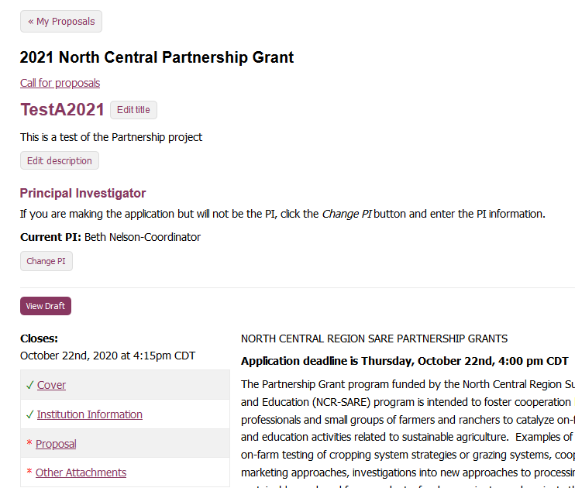
If all required questions in a section are complete, the section will be marked with a green check.
Click on “Proposal”
Notes:
Once all required questions in a section are complete, the section will be marked with a green check.
Click on “Proposal” to enter information in the main body of the proposal.

Slide 30
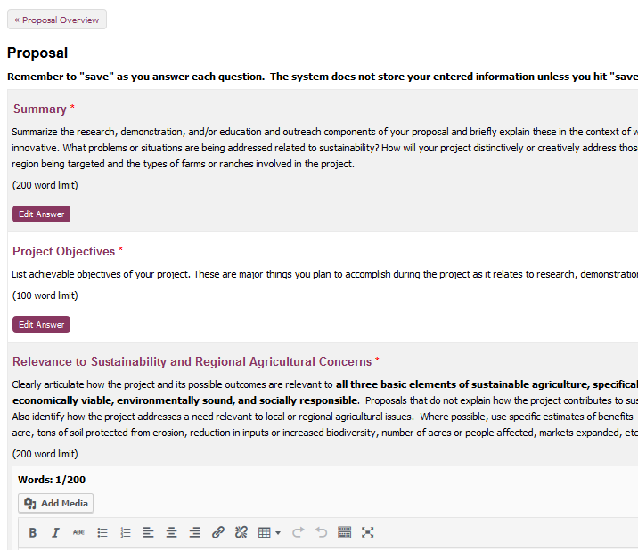
Some sections allow you to add images or tables. Click on “add media”.
Limit images/table to the equivalent of one two-sided page.
Notes:
You will enter the body of your proposal here. Note that most sections have word limits. You can add images or tables in sections that have an “add media” button, but please limit your images to no more than one page (front and back).To go back to your main page, click on “Proposal Overview.”

Slide 31
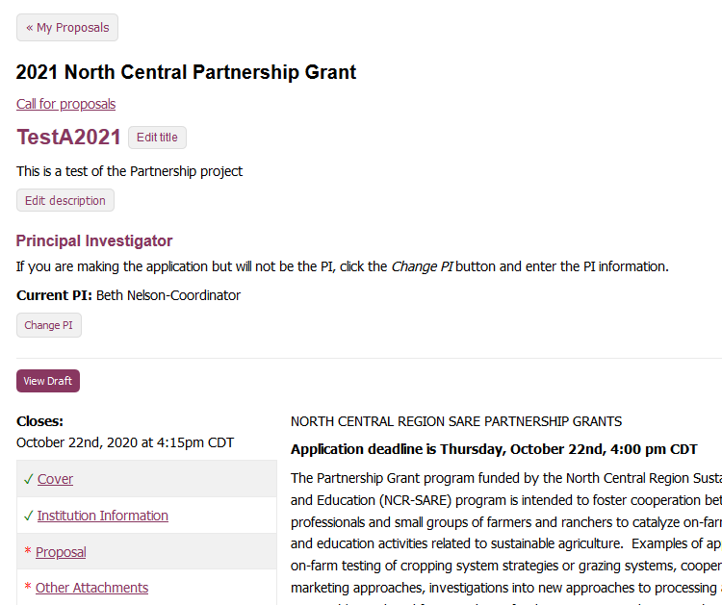
You can view a draft of your proposal at any time.
Notes:
To view or share your draft proposal, click on “View draft”

Slide 32
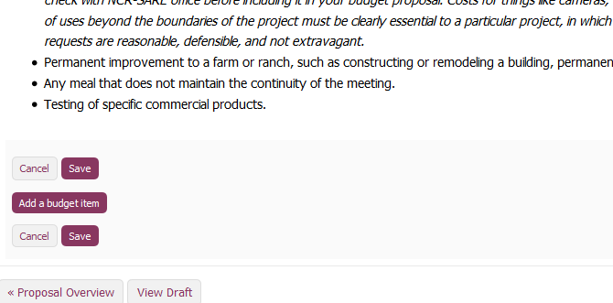
Complete the budget by entering each item here
Notes:
You will enter each item in the budget.

Slide 33
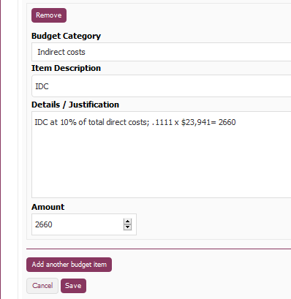
Complete information for first item, then click “save” to save that budget item—
Click edit answer to go back in and
“Add another budget item”
Notes:
Select the major budget category from the drop down list, provide a brief item description, provide a more detailed budget justification for how you arrived at that number, as described in the instructions, and the total amount. We suggest you save each budget item as you enter it, even though you have to then again click “edit answer” to add the next budget item. Entered information is not stored in the system until you “save”, so if you enter several budget items without saving, then something happens to interrupt the system before saving you will lose all the entries not saved.

Slide 34
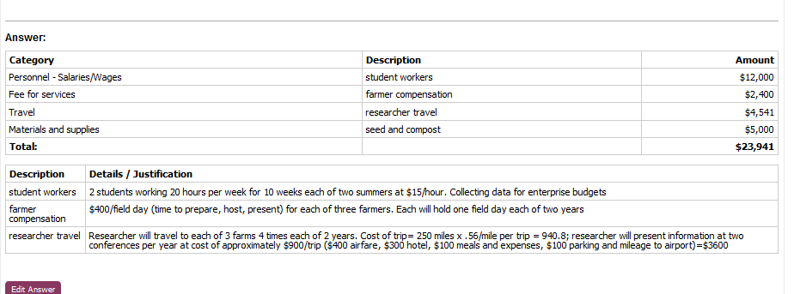
Once you’ve entered your direct costs, you can use the total direct cost to calculate indirect costs. $23,941 x .1111 = $2660.
Notes:
You’ll see a table with the simple item description and the amount, and a separate table below that provides the more detailed justification.
When you’ve added in all your direct costs, use the total to calculate indirect costs. Multiply the direct cost total by .1111 to get indirect costs. In this example, that will be $2660.

Slide 35
Add $2660 as a budget item as “Indirect Costs” –this will be 10 percent of the total funds requested.
Notes:
Add $2660 as a budget item, identified as Indirect Costs from the drop down menu.

Slide 36
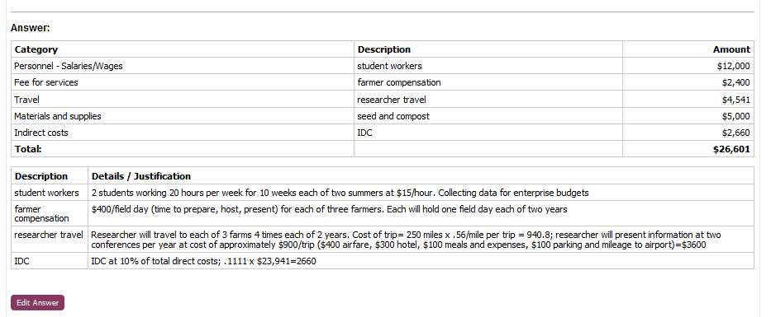
Notes:
This is how your budget question will look.

Slide 37
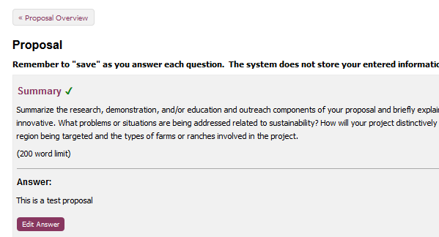
Notes:
To return to this proposal’s main page, click on “Proposal Overview”

Slide 38
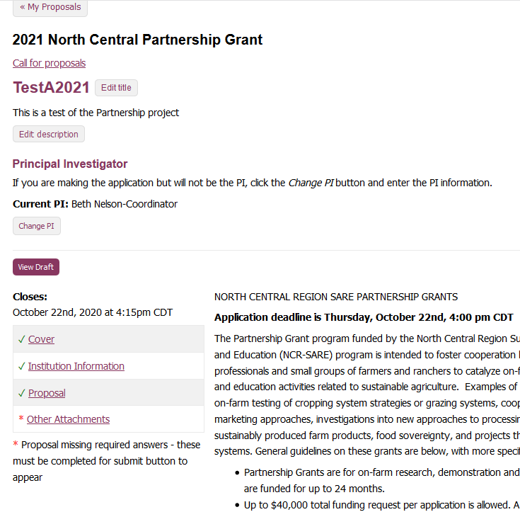
Notes:
Go to the “other attachments” section.

Slide 39
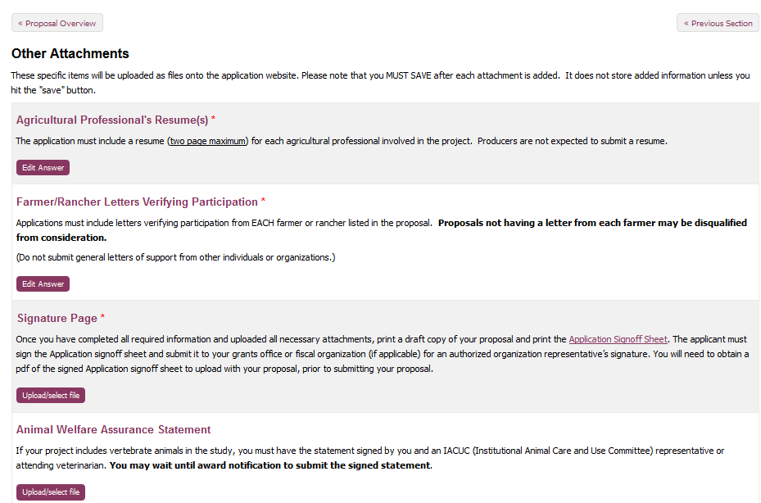
Notes:
Click on the appropriate sections to upload Ag professional resumes and Farmer/Rancher letters verifying participation.

Slide 40
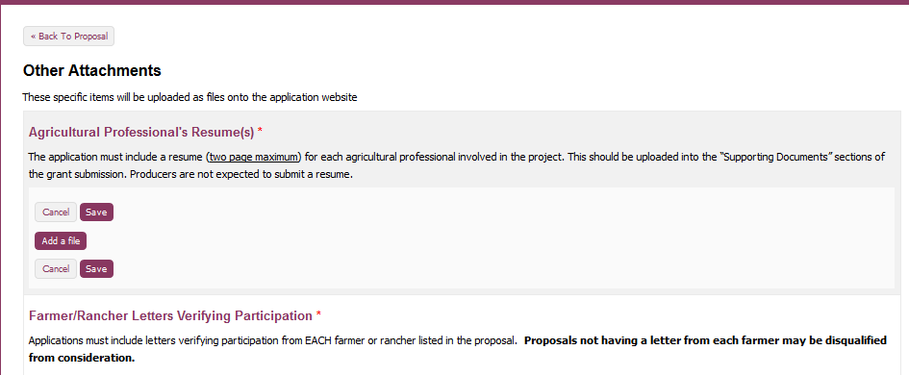
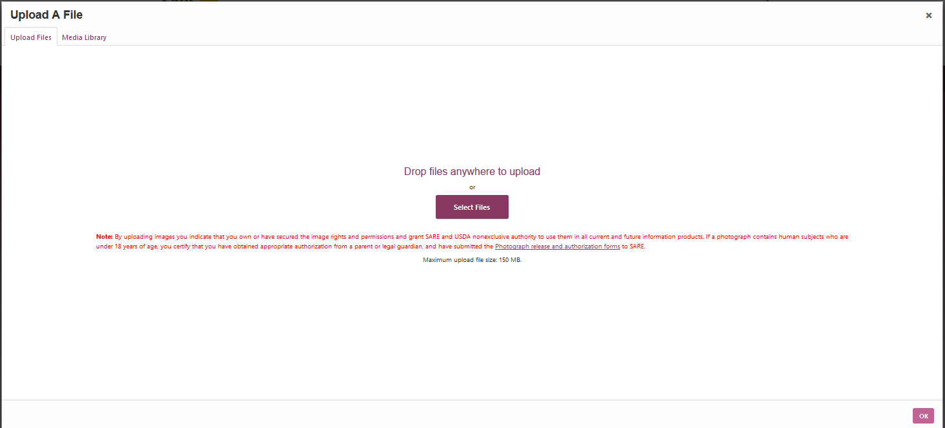
Notes:
Click on “add a file”, then click on “select file” to upload from your computer.

Slide 41
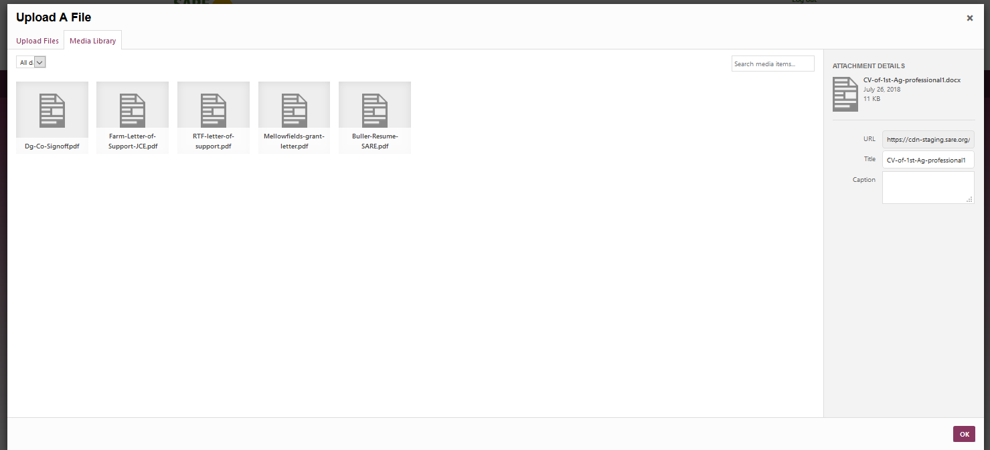
Notes:
On the far right you should see the title of the uploaded file. You can provide a caption if you’d like, otherwise it will use the file name. You must click the box “ok” in the lower right hand corner to upload your file into the media file

Slide 42
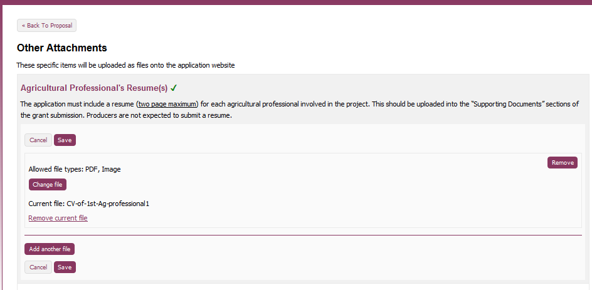
Notes:
It will have added your file as Current file. Note that you can change the file or remove it. You can click on add another file to add a second c.v.

Slide 43
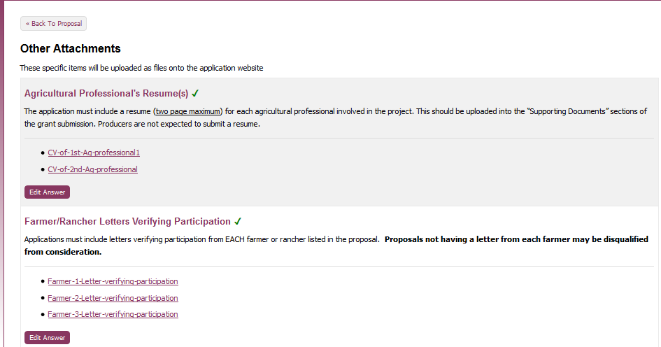
Notes:
In this shot, you’ll see I’ve uploaded 2 cvs for ag professionals, and 3 letters verifying participation.

Slide 44
Notes:
Next—print off the Application Signoff Sheet pdf, which is linked in the signature page question.

Slide 45
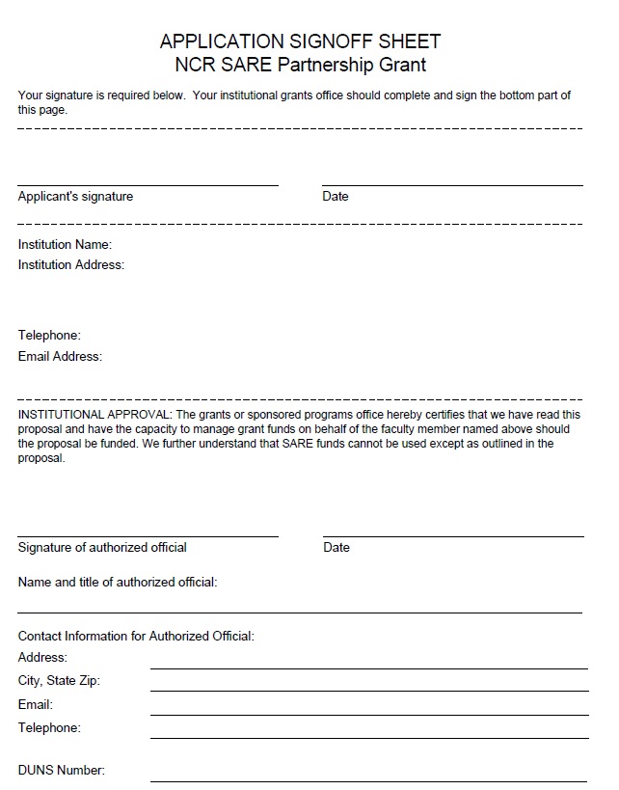
Signoff Sheet: Print, sign, and submit to your institution’s grant office to complete and sign.
You will upload pdf of pages with all signatures in the signature question of the “other attachments” section
Notes:
Complete the institution information (or have your authorized organizational representative complete) and submit with the draft of your proposal to your grants office or person who is authorized to sign for your organization. Ask them to provide a pdf of the signed page, and you will then upload that to your proposal prior to submission. This signed form must be submitted by the closing date, so allow extra time for your organization to review your proposal and sign off. Some grant offices require a week or more to complete this.

Slide 46
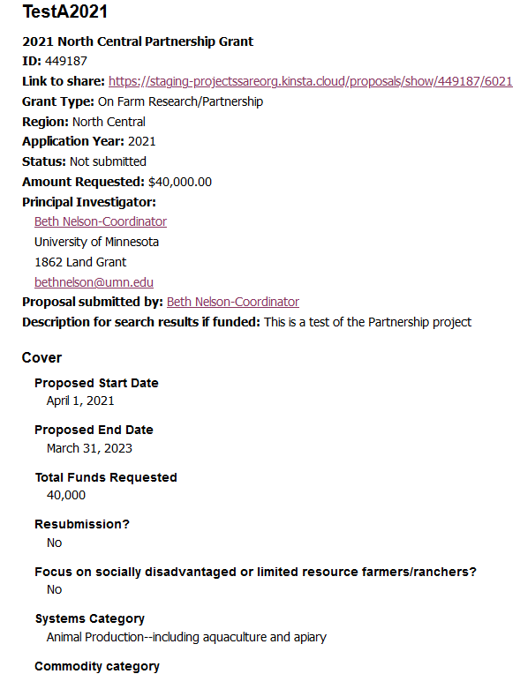
Link to share draft with collaborators
Notes:
You can share the draft when you’re ready.

Slide 47
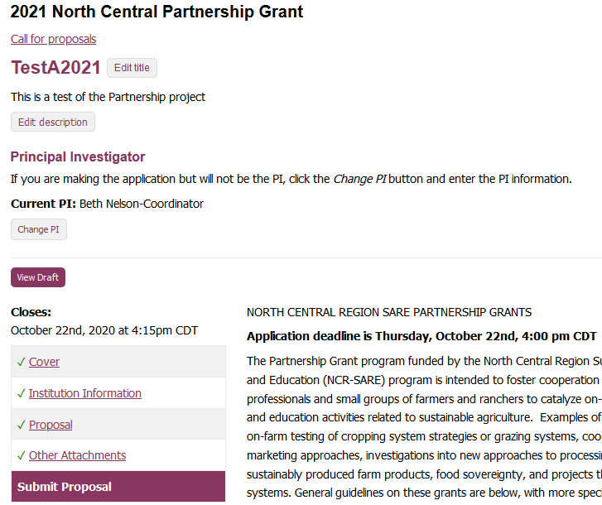
Note that the “Submit Proposal” button ONLY APPEARS once all require items are completed
Notes:
Once you’ve uploaded the signature page, and all required sections are complete, the "submit proposal" button will appear. If you don't see the submit buttton, you are missing a required component. Check to see that you've completed the title and the project description, those are often overlooked. Once you see the submit proposal button, you can proceed to submit your proposal.

Slide 48
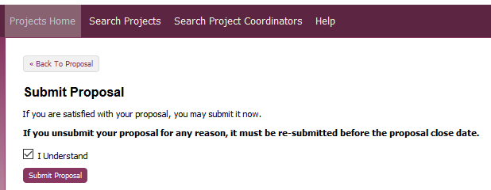
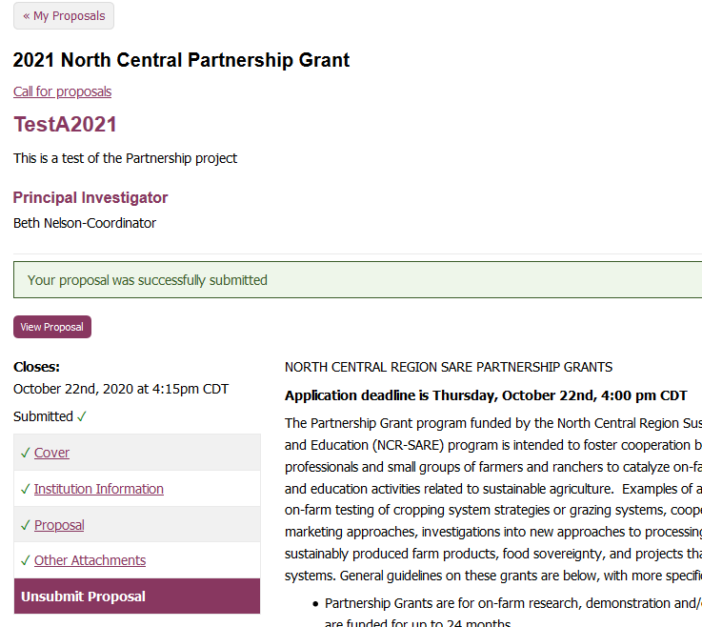
Notes:
Submit proposal, noting that in this system you do have the option to “unsubmit”, but you must resubmit prior to the proposal deadline.

Slide 49
Once you’ve submitted your proposal, you should receive a confirmation email. If you don’t, check the email address you used in the system to make sure it is correct. If that’s not the issue, notify us.
Notes:
You’ll receive a confirmation email—if you don’t, check the email address you used in the system. If there’s a mistake, correct it, and then let us know so we can check and make sure that your proposal is submitted.

Slide 50
Timeline
2021 Partnership Program
Grant Cycle
Oct. 22, 2020 Proposals due online by 4:00 pm CDT
Early Feb. 2021 Applicants notified
April 1, 2021 Funds available to applicants
March 1, 2022 2021 Annual report due
Project end date Final report due 60 days after project end date
Photo courtesy Wayne Martin
Notes:
This is the timeline for the 2021 Partnership grant program. Your proposal, including the signed authorization, must be submitted online by Thursday, October 22nd, at 4:00 p.m. CDT. They’ll be reviewed and a recommendation made to the NCR-SARE Administrative Council in January, and all applicants will be notified whether or not they are awarded in February. We anticipate that funds will be available for you to begin your project April 1, 2021.

Slide 51
Contact for more information
Beth Nelson, phone 612.626.4436
email bethnelson@umn.edu
Rob Myers, phone 573.882.1547
email myersrob@missouri.edu
North Central SARE Office,
phone 612.626.3113
email ncrsare@umn.edu
www.northcentralsare.org
Advancing sustainable agriculture since 1988
Notes:
Beth Nelson and Rob Myers are co-coordinating the grant program, so feel free to contact either one of us if you have questions about preparing a proposal for this grant program. You can also contact the main SARE office with questions. We look forward to receiving your proposal.

